Slide 1


How to use an indication rule to retrieve all records with no language in the 008 field
Yoel Kortick
Senior Librarian
http://continuumgrc.com/infinite-library/

Slide 2








Introduction
Creating an indication rule
Customizing the indication rule
Testing the indication rule
Filter a set using the indication rule
Checking the results
Text for number 7
http://s3.thingpic.com/images/zp/timHgbybX5e9UqMUf6oYyVQM.jpeg
http://image.shutterstock.com/z/stock-photo-business-hand-writing-blank-agenda-list-130255148.jpg

Slide 3
Introduction
This presentation will outline the steps to retrieve all records which have a 008 with position 35-37 blank.
We will
Build an indication rule which will find the records
Make a set of all records in which we want to search
Filter the set using the indication rule
Final result will be a set of all the records which meet the condition of the rule (have pos. 35-37 of 008 blank)

Slide 4
Introduction
Creating an indication rule
Customizing the indication rule
Testing the indication rule
Filter a set using the indication rule
Checking the results
Text for number 7
http://s3.thingpic.com/images/zp/timHgbybX5e9UqMUf6oYyVQM.jpeg
http://image.shutterstock.com/z/stock-photo-business-hand-writing-blank-agenda-list-130255148.jpg

Slide 5
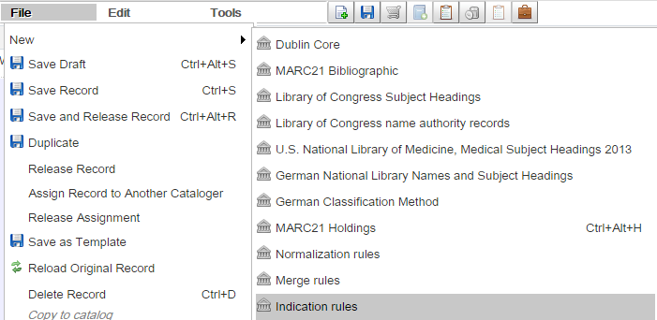
Creating an indication rule – option 1
An indication rule can be created via the following methods
1. “File > New > Indication Rules” in the metadata editor

Slide 6
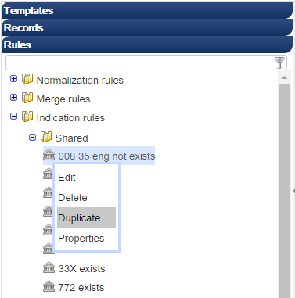
Creating an indication rule – option 2
2. Duplication an existing rule of the institution (shared or private) in the navigation pane of the metadata editor

Slide 7
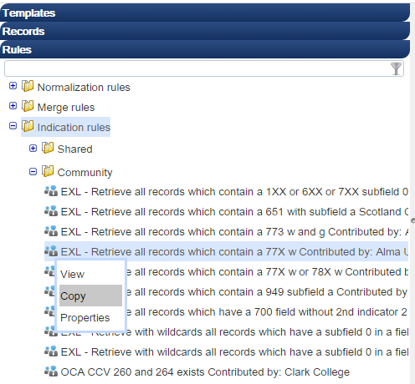
Creating an indication rule – option 3
3. Copy an indication rule from the community to your institution

Slide 8
Creating an indication rule
The recommended method is to copy an existing rule and then edit it. This is easier than creating one from scratch.
Find an existing rule closest to the goal of the new indication rule being built, duplicate or copy it, and then edit it.

Slide 9
Introduction
Creating an indication rule
Customizing the indication rule
Testing the indication rule
Filter a set using the indication rule
Checking the results
Text for number 7
http://s3.thingpic.com/images/zp/timHgbybX5e9UqMUf6oYyVQM.jpeg
http://image.shutterstock.com/z/stock-photo-business-hand-writing-blank-agenda-list-130255148.jpg

Slide 10
Customizing the indication rule
To customize the indication rule to do exactly what you want see the syntax and examples.
These can be found at
On the On Line Help under section “Indication Rules Syntax Examples”
In a series of documents about using the rules on the Knowledge Center at: https://knowledge.exlibrisgroup.com/Alma/Product_Materials/Overview_Materials/Presentations_and_Documents#Rules

Slide 11
Customizing the indication rule
This is a rule to find all records which have eng (English) in position 35-37 of the 008
rule "have blank for 008 pos. 35-37 (language)"
when
existsControl "008.{35,3}.eng"
then
set indication."true"
end

Slide 12
Customizing the indication rule
The rule can be easily edited to find all records which have a blank in position 35 to 37 of the 008.
Just change the ‘eng’ to three blanks.
rule "have blank for 008 pos. 35-37 (language)"
when
existsControl "008.{35,3}. "
then
set indication."true"
end
Three blanks

Slide 13
Introduction
Creating an indication rule
Customizing the indication rule
Testing the indication rule
Filter a set using the indication rule
Checking the results
Text for number 7
http://s3.thingpic.com/images/zp/timHgbybX5e9UqMUf6oYyVQM.jpeg
http://image.shutterstock.com/z/stock-photo-business-hand-writing-blank-agenda-list-130255148.jpg

Slide 14
Testing the indication rule
You can test the rule by
Opening the metadata editor in split editor mode
Put record on left side
Put indication rule on right side
Click “Try it”

Slide 15
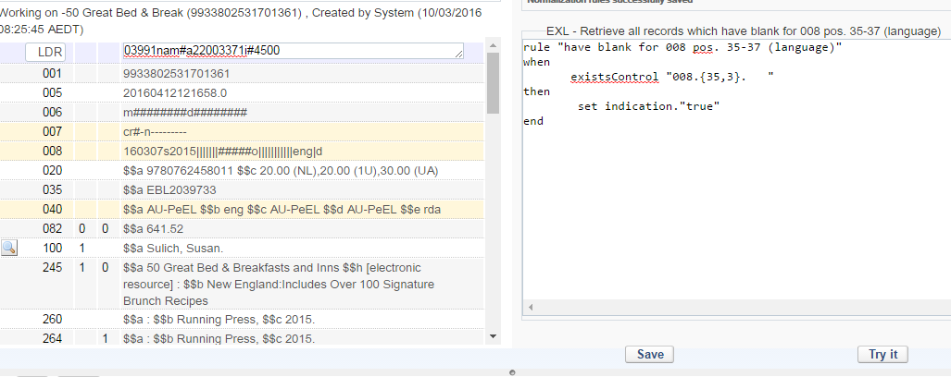
Testing the indication rule
This should be “false” because the record has eng in pos. 35-37 and the rule looks for blanks
Rule looks for blanks
Record has eng
Click ‘Try it’

Slide 16
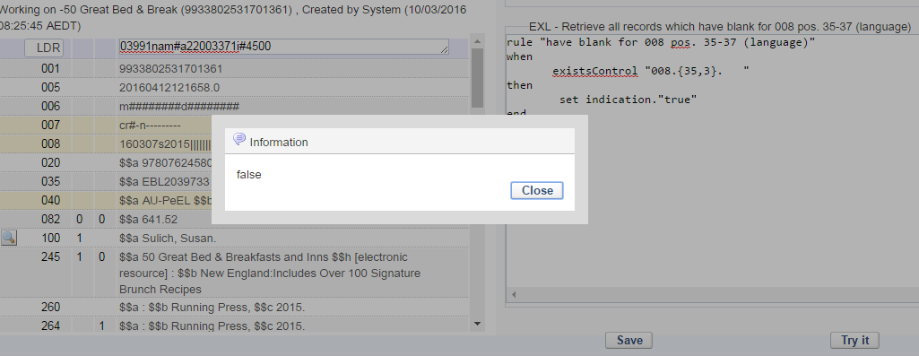
Testing the indication rule
After clicking ‘Try it’ Alma correctly returns the message ‘False’

Slide 17
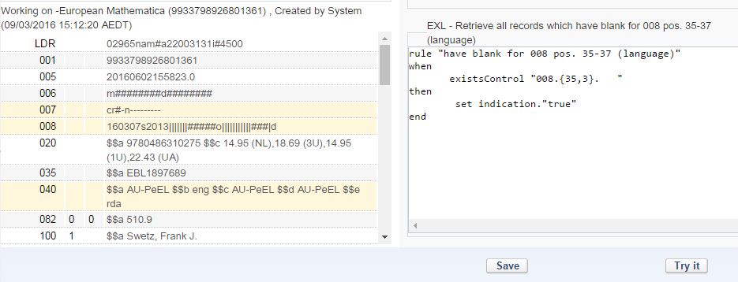
Testing the indication rule
Now we have a record which really does have blanks in the 008 position 35 -37 (which are represented as ###).
Again we will click “Try it” using the same rule
Rule looks for blanks
Record has blanks
Click ‘Try it’

Slide 18
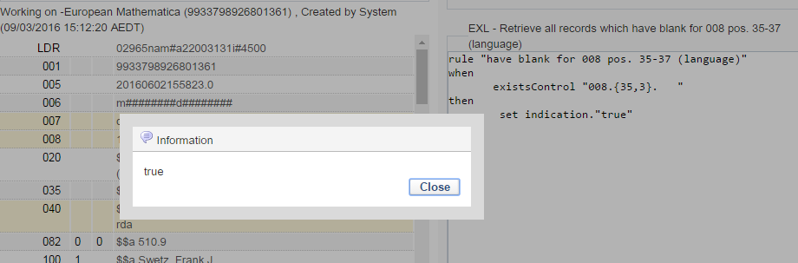
Testing the indication rule
After clicking ‘Try it’ Alma correctly returns the message ‘True’

Slide 19
Introduction
Creating an indication rule
Customizing the indication rule
Testing the indication rule
Filter a set using the indication rule
Checking the results
Text for number 7
http://s3.thingpic.com/images/zp/timHgbybX5e9UqMUf6oYyVQM.jpeg
http://image.shutterstock.com/z/stock-photo-business-hand-writing-blank-agenda-list-130255148.jpg

Slide 20
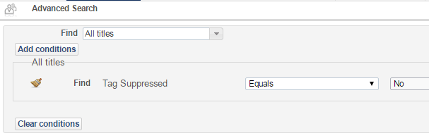
Filter a set using the indication rule
Here we have made a set of all records in the institution which are not suppressed

Slide 21
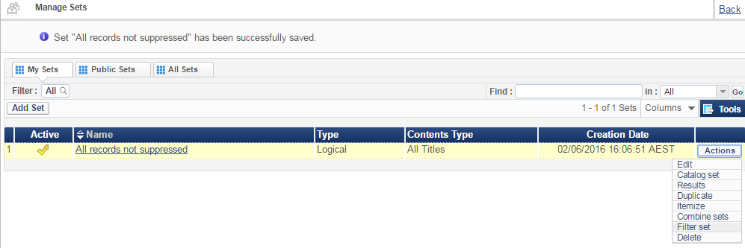
Filter a set using the indication rule
From “Manage Sets” we will filter the set

Slide 22
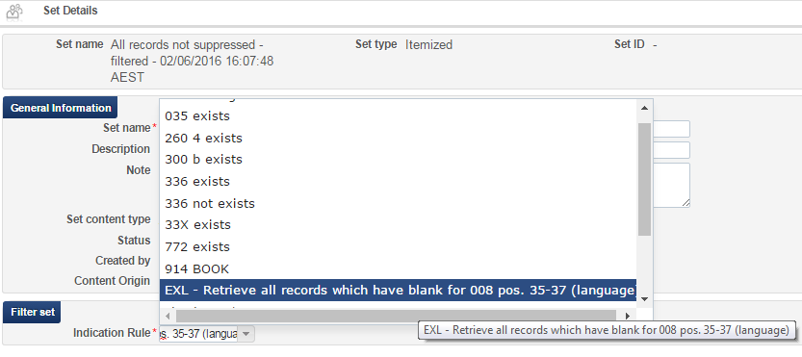
Filter a set using the indication rule
We will chose the indication rule we just made which looks for blanks in position 35-37.

Slide 23
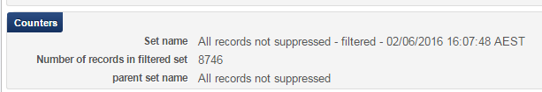
Filter a set using the indication rule
A “Filter set by indication” job is sent and completes successfully
The report states that 8746 records were found with the filter

Slide 24
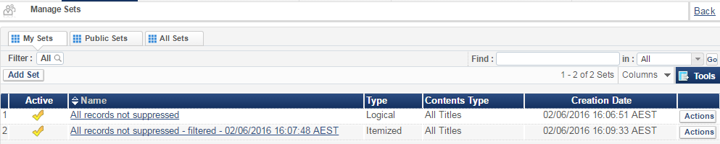
Filter a set using the indication rule
A new set is created and contains only those records which meet the criteria of the indication rule

Slide 25
Introduction
Creating an indication rule
Customizing the indication rule
Testing the indication rule
Filter a set using the indication rule
Checking the results
Text for number 7
http://s3.thingpic.com/images/zp/timHgbybX5e9UqMUf6oYyVQM.jpeg
http://image.shutterstock.com/z/stock-photo-business-hand-writing-blank-agenda-list-130255148.jpg

Slide 26
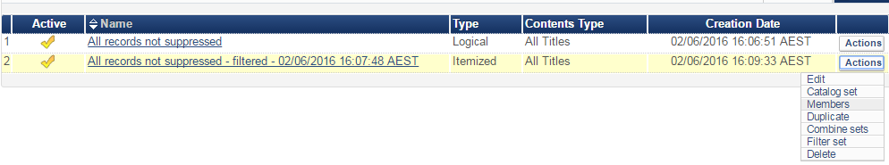
Checking the results
On the new set we’ll choose ‘Members’ and then check the first two results.

Slide 27
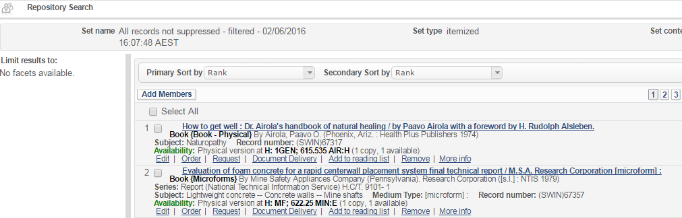
Checking the results
Let’s check the first record “How to get well …”

Slide 28
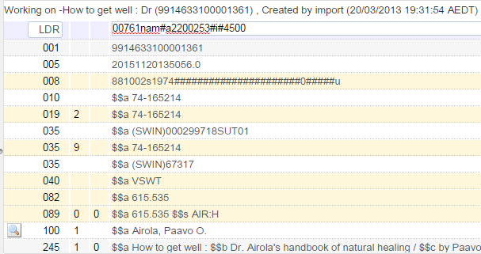
Checking the results
We see that pos. 35 to 37 of the 008 is blank

Slide 29
Checking the results
Let’s check the second record “Evaluation of foam concrete …”

Slide 30
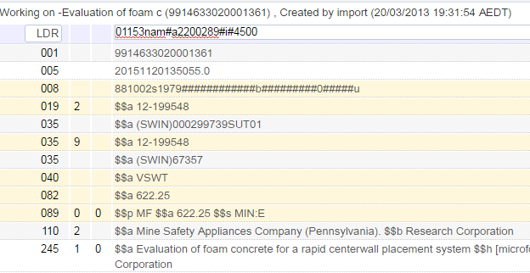
Checking the results
We see that pos. 35 to 37 of the 008 is blank

Slide 31
Checking the results
The results show that now we have a set of records for which the 008 position 35-37 is blank.

Slide 32
Thank You
Yoel Kortick
Senior Librarian
http://continuumgrc.com/infinite-library/

